Slide 1

On being Bayesian Vienna 9 November 2016
Stephen Senn
Notes:
On being Bayesian
Stephen Senn, Luxembourg Institute of Health
Abstract: Thanks partly to progress in computing but also in statistical understanding, the last quarter of a century has seen a dramatic rise in the use of "Bayesian" methods. The use of the inverted commas is deliberate. What all these analyses share in common is the use of Bayes theorem to combine prior distributions and data to form a posterior probability statement. However, this is not enough to make the process pass the requirement of Bayesian coherence and most of them would not pass this test.
My talk will be in two main parts. In the first part I shall take two apparently simple examples and show that things are perhaps not so simple after all and that apparently elementary problems can have disturbing implications. In the second part I shall take a (potentially) important problem in drug development, the use of historical data, to try and illustrate what a true Bayesian analysis really needs.
I conclude with some suggestions as to how one might approach the process of thinking about and constructing prior distributions.

Slide 2

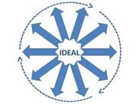
Acknowledgements
Thank you for the kind invitation
This work is partly supported by the European Union’s 7th Framework Programme for research, technological development and demonstration under grant agreement no. 602552. “IDEAL”
The work on historical placebos is joint with Olivier Collignon and Anna Schritz in my group
(c) Stephen Senn
2

Slide 3
Basic Thesis
The Bayesian approach holds out the promise of providing a principled way of synthesizing difference sources of information
This is, however, more difficult than many suppose
Key tasks are
Appropriate formulation of prior distributions
Establishing exactly what the objective content of such prior distributions is
Understanding what a prior distribution commits you to believe
Developing insight (mathematics is not enough)

Slide 4
Characteristics of prior distributions
They must be what you would use to bet on in advance of getting any further data
No amount of further data in any form should be capable of causing you to revise your prior distribution qua prior
Updating your prior distribution to become a posterior is quite another matter
Remember that to the extent defined by the model the prior distribution and the data are exchangeable
Wanting to change your prior is like wanting to change some data

Slide 5
An example to get you started
You are proposing to estimate the probability θ of a binary event
E.g. cure/no cure
You use a uniform prior on θ
You now proceed to study 10,000 occurrences
Which does your prior distribution say is more likely?
10,000 successes
5,000 successes 5,000 failures, in any order

Slide 6
Case Ascertainment
One of the things we learn in statistics is that it matters how we ascertain cases
The selection procedure affects our inferences
We react differently if we learn that the results we are being shown are from a treatment that was one of many if it was chosen randomly or it was chosen as the best observed

Slide 7
A Selection Paradox of Dawid’s
Suppose that we estimate treatment means from a number of treatments in clinical research
We use a standard conjugate prior
Since Bayesian analysis is full conditioned on the data, then for any treatment the posterior mean will not depend on why we have chosen the treatment
At random
Because it gave the largest response
See DAWID, A. P. (1994), in Multivariate Analysis and its Applications, eds. T. W. Anderson, K. a.-t. a. Fang, & I. Olkin

Slide 8
A Simulation to Illustrate This
Simulate 10 true means
For each true mean simulate observed value
Now select in one of two ways
Randomly choose one member from each group of 10
Choose the member with the highest observed mean

Slide 9
What the Bayesian theory says

Slide 10
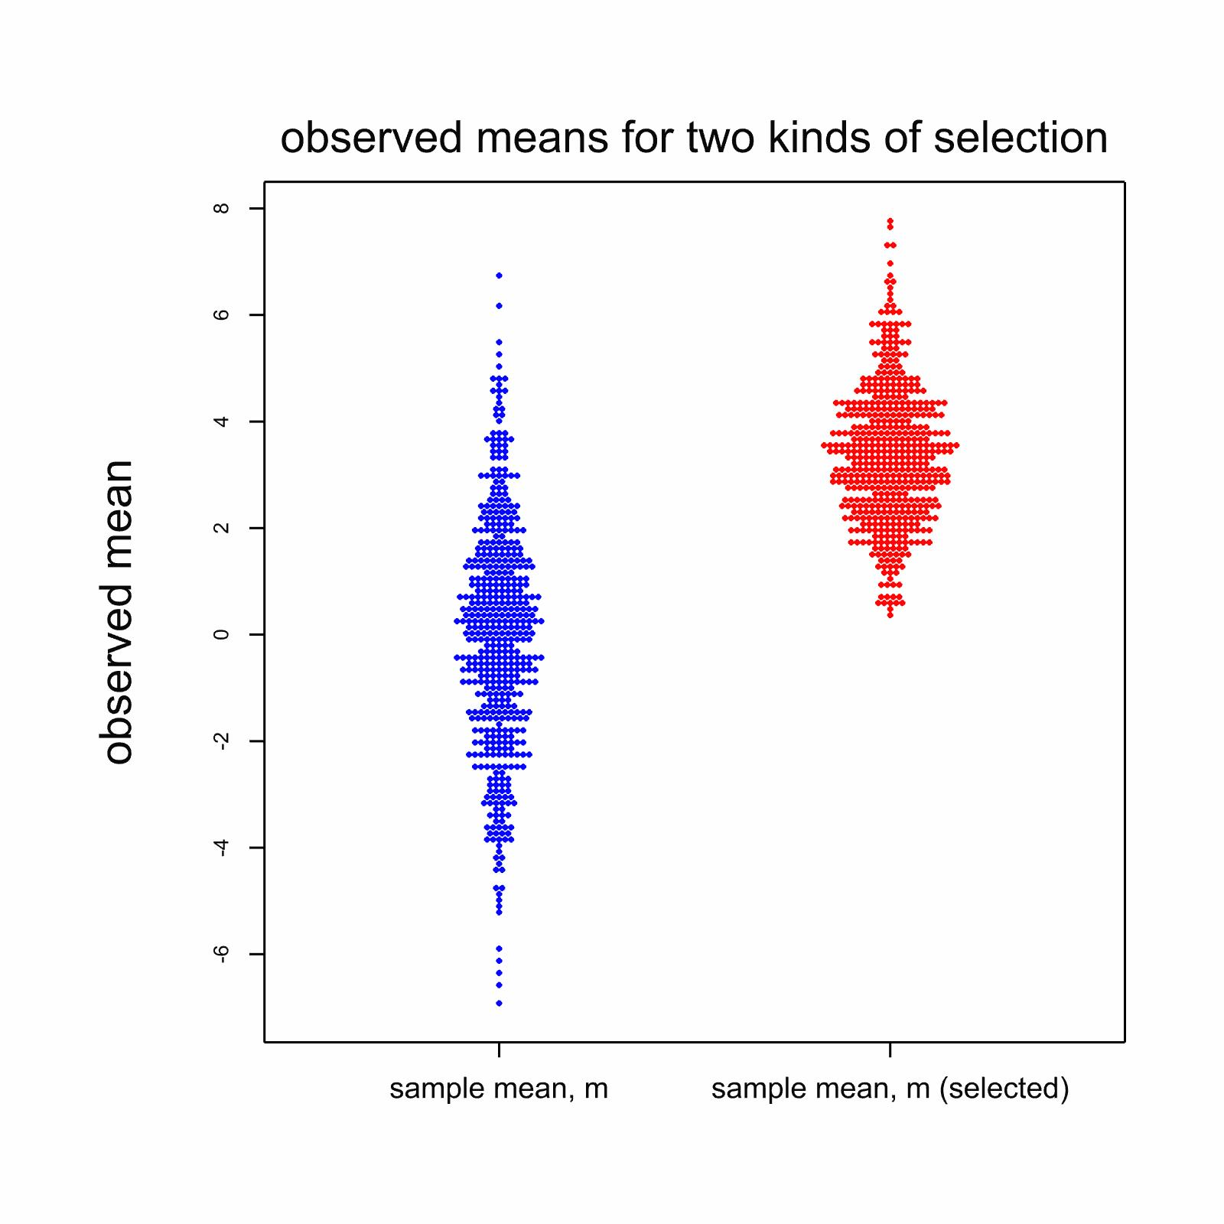
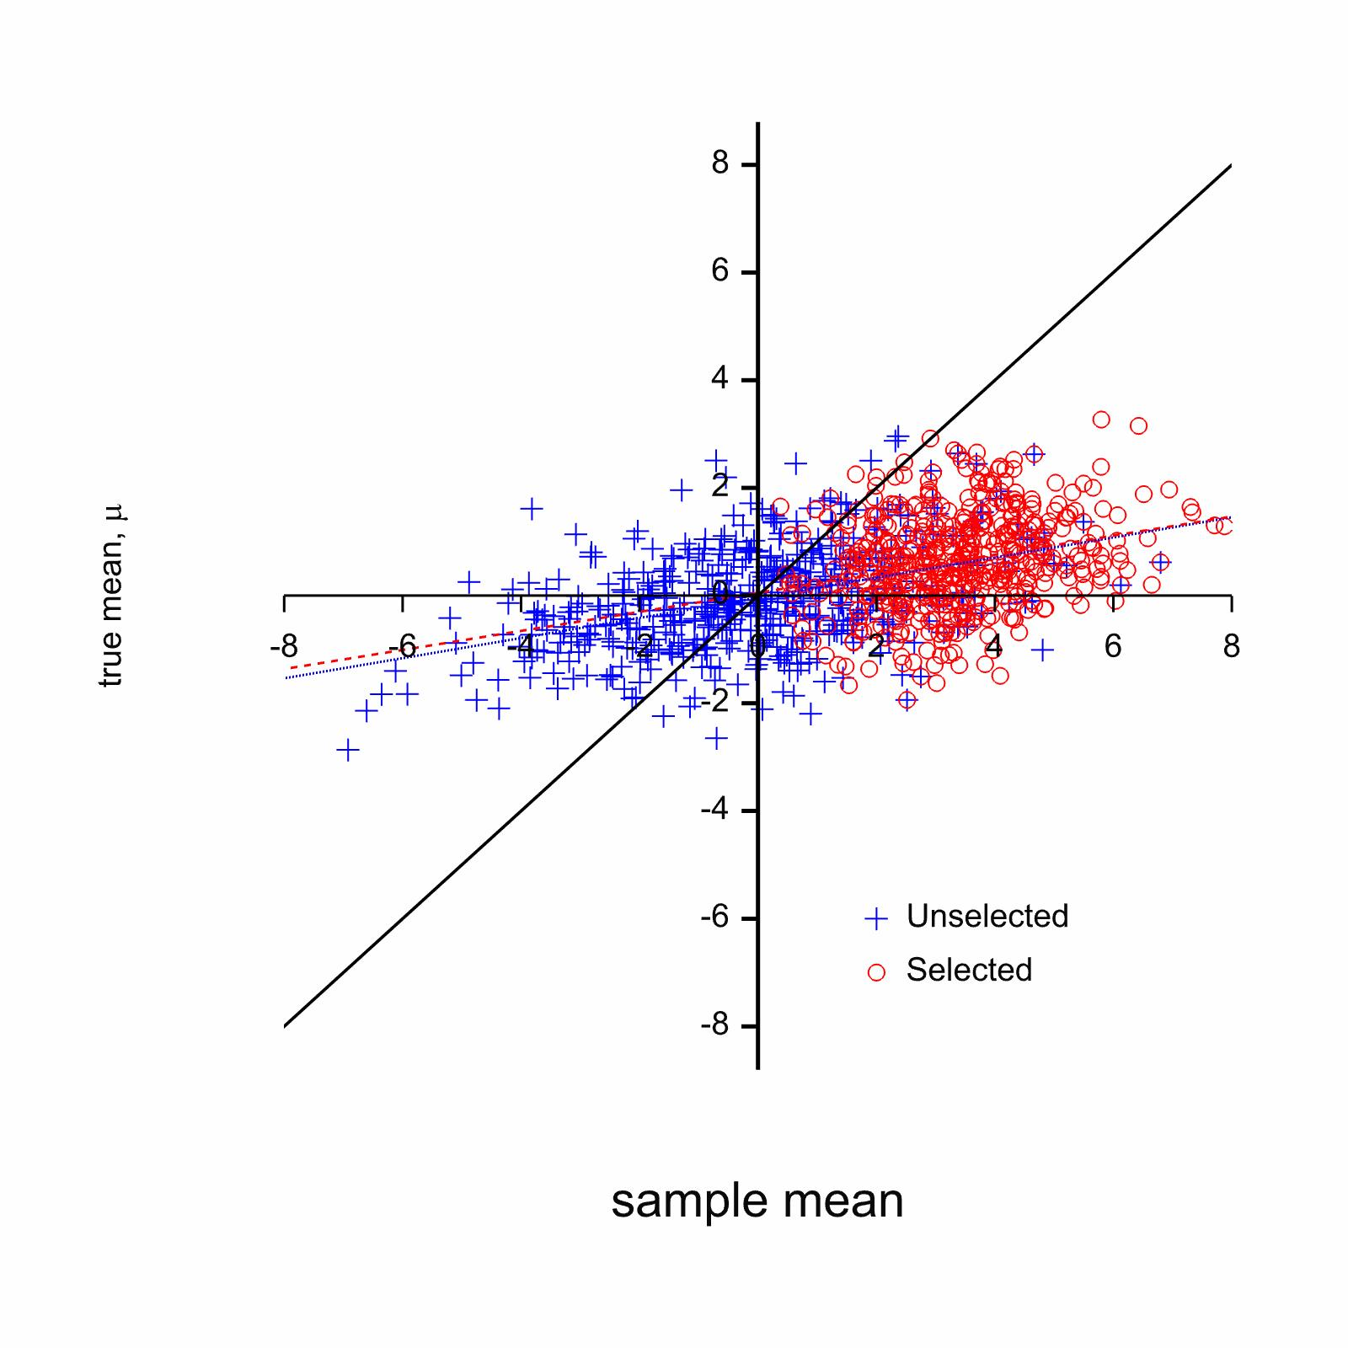
What the simulation shows
Notes:
The left hand dot histograms shows the distribution of the observed means. Clearly there is a big difference between randomly selected and extreme selected means
The right hand show the empirical regression of true on observed means. The regression lines are virtually indistinguishable.
The only thing that matters is the size of the observed mean and not how it was selected

Slide 11
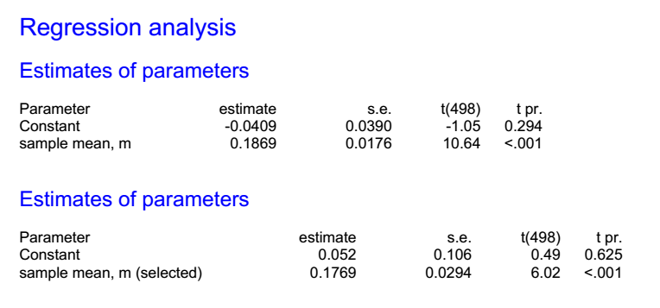
Theory says 0.2
Notes:
So, allowing for sampling variation, the simulation shows what the theory predicts and there is no difference, apart from sampling variation, between the case where the mean is chosen randomly and it is chosen as being more extreme

Slide 12
Does this mean the frequentist intuition is wrong?
Not necessarily
One needs to think carefully about what the prior distribution implies
Actually, even if the prior variance were large the prior distribution would be very informative about two things
Normality
Conditional independence
Notes:
The Bayesian formulation is much more informative than one might suppose

Slide 13
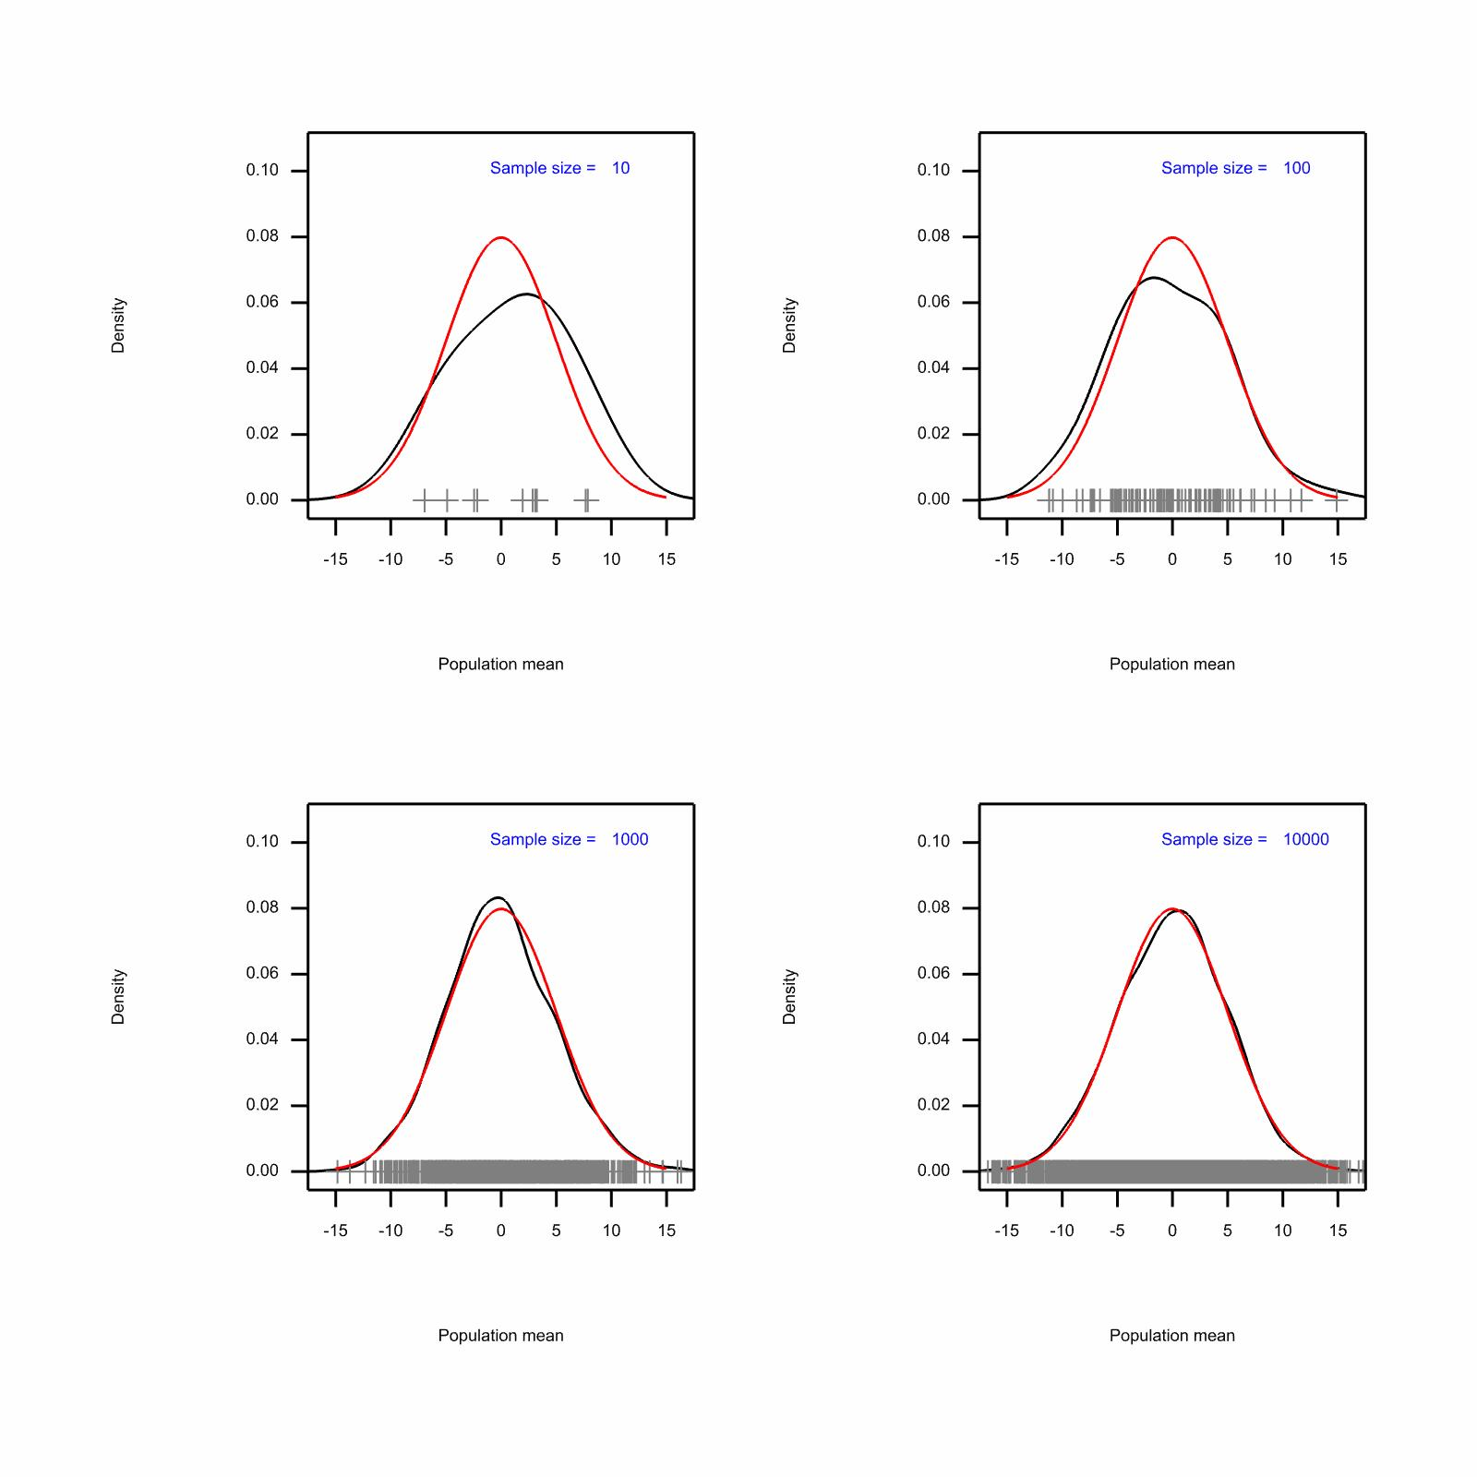
Notes:
These are density estimates with parametric Normal distributions superimposed for different sample sizes. It shows that you need rather a large sample of true means to have approximately the information seen in a ‘prior distribution’

Slide 14
The explanation of the paradox
Having a Normal prior is equivalent to having seen thousands of true means
Furthermore, a priori, the true mean of any value in your sample of ten is exchangeable with any one of these thousands of means
Why should the fact that it is locally the highest have any effect on your Bayesian calibration?
Now let us see what happened when we no longer make the means exchangeable

Slide 15
A hierarchical simulation
Simulate cluster mean
Then simulate for cluster members
Simulation run two ways
Randomly choose one member from each group of 10
Choose the member with the highest observed mean
Notes:
The previous total variance

Slide 16
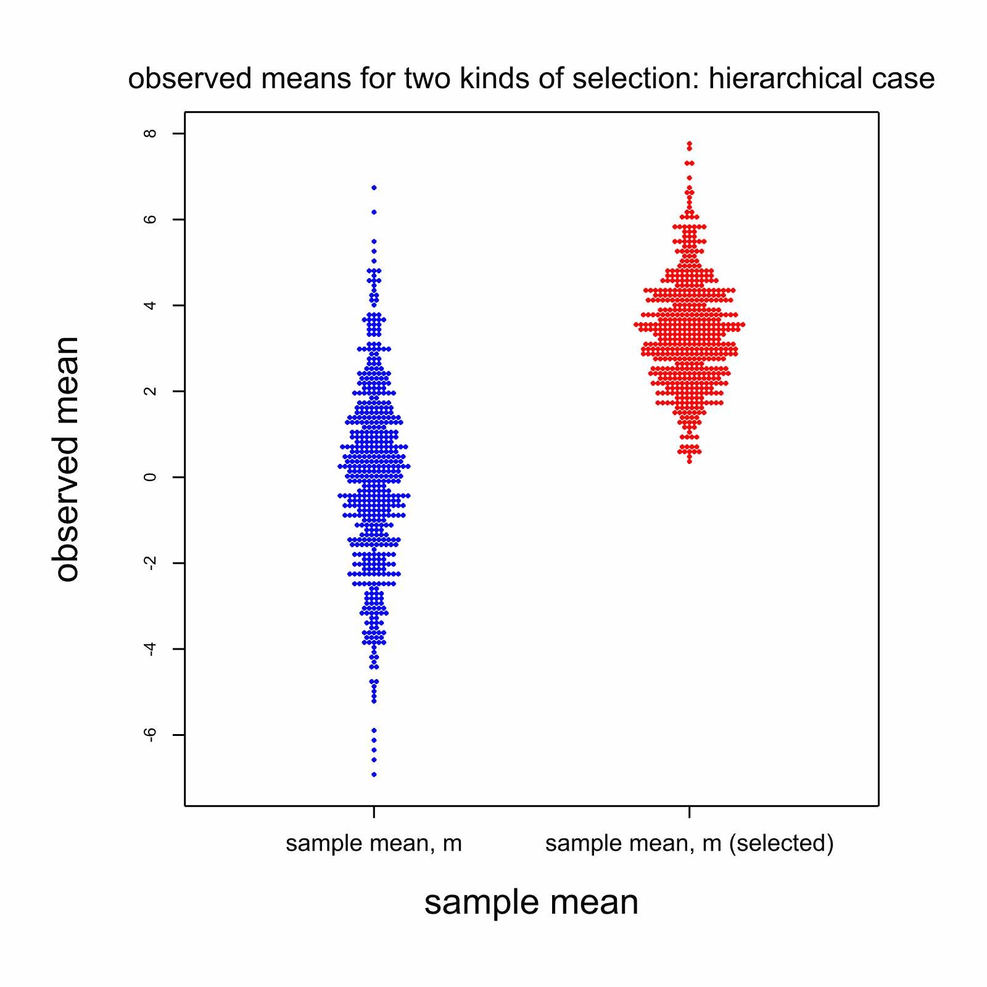
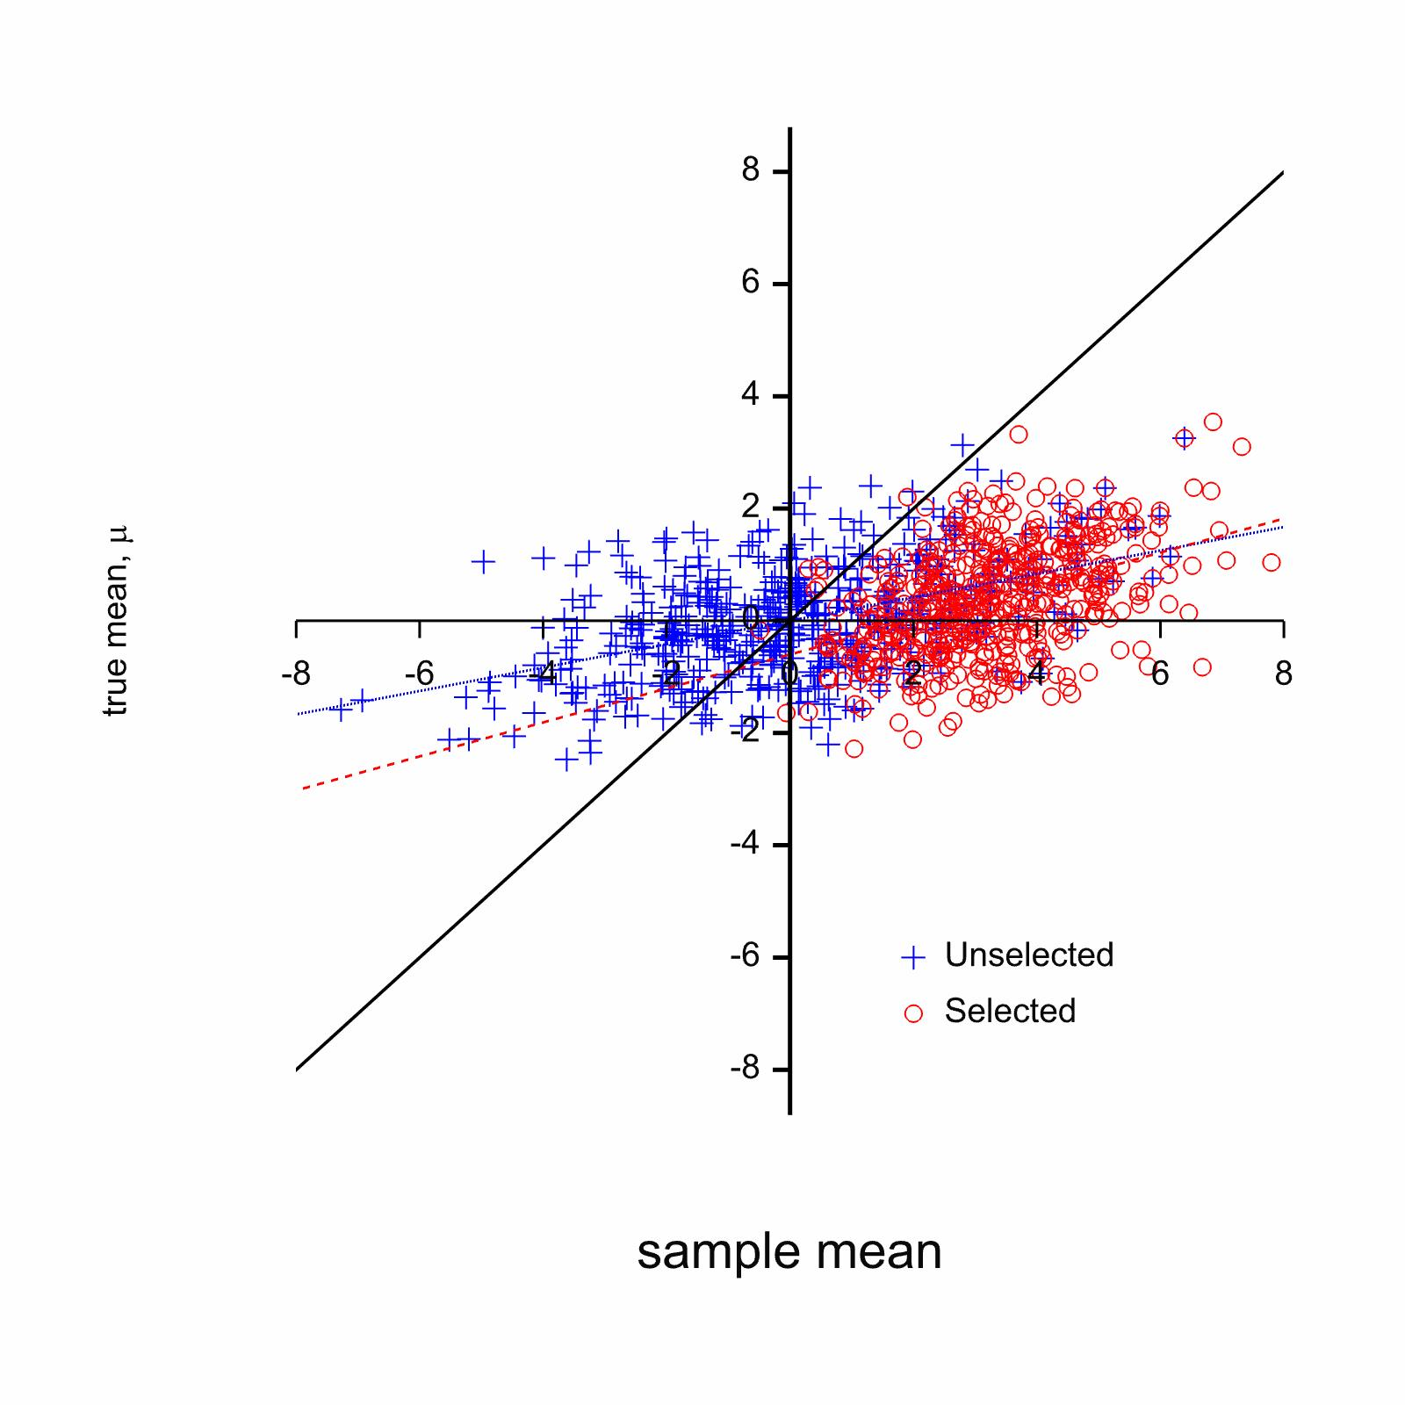
What the simulation shows
Notes:
The left hand dot histograms shows the distribution of the observed means. Clearly there is a big difference between randomly selected and extreme selected means
The right hand show the empirical regression of true on observed means. The regression lines are now different.
How the mean was selected is now important

Slide 17
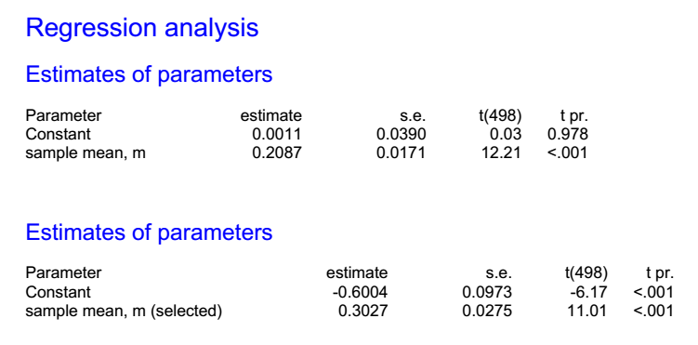
The regression equations are now quite different depending on how the means were chosen

Slide 18
Lessons
As soon as you replace the conjugate prior with a hierarchical one you get very different results according to selection
Be very careful to establish what your prior implies
True Bayesian inference does not necessarily give you the license to ignore frequentist lessons you might think

Slide 19
Historical control
In many indications, the same treatment is often used as a control
Either a placebo
Or a standard treatment
This means that when a new treatment is trialled there will be a lot of information from previous trials on the control being used
Since Bayes is supposed to be a way of synthesizing all information, how would we do this?

Slide 20
Problem
Obviously a historical control is not worth the same as a concurrent control
How should we deal with this?
Ask the following question
Given a choice between an infinite number of historical controls and n concurrent controls how large does n have to be before I prefer the latter?

Slide 21
Model (frequentist formulation)

Slide 22
But….
When you start thinking like this you begin to wonder
Is it really the number of historical control patients that I have that is important?
Or should I really be thinking about the data in some other way?
What do the data really represent?

Slide 23
The TARGET study
One of the largest studies ever run in osteoarthritis
18,000 patients
Randomisation took place in two sub-studies of equal size
Lumiracoxib versus ibuprofen
Lumiracoxib versus naproxen
Purpose to investigate cardiovascular and gastric tolerability of lumiracoxib
That is to say side-effects on the heart and the stomach
Notes:
23
This was at the time probably the largest controlled study ever run in osteoarthritis. More that 18,000 patients were entered into the study. Although the condition being treated was osteoarthritis, it was not the primary purpose of the trial to compare the treatments as regards their effects on this condition; it was taken as a given that all three were effective in osteoarthritis. Instead, the treatments were compared as regards their gastric (GI) (Schnitzer, et al.,2004) and cardiovascular (CV) (Farkouh, et al.,2004) side-effects. Lumiracoxib is a so-called COX-II inhibitor. It was expected to have fewer GI side-effects than Naproxen and Ibuprofen, which were established non-steroidal anti-inflammatory drugs (NSAIDs). On the other hand it was considered possible that COX-II inhibitors, including lumiracoxib, might have more CV side-effects.

Slide 24
Baseline Demographics
 | Sub-Study 1 |  | Sub Study 2
Demographic Characteristic | Lumiracoxib n = 4376 | Ibuprofen n = 4397 | Lumiracoxib n = 4741 | Naproxen n = 4730
Use of low-dose aspirin | 975 (22.3) | 966 (22.0) | 1195 (25.1) | 1193 (25.2)
History of vascular disease | 393 (9.0) | 340 (7.7) | 588 (12.4) | 559 (11.8)
Cerebro-vascular disease | 69 (1.6) | 65 (1.5) | 108 (2.3) | 107 (2.3)
Dyslipidaemias | 1030 (23.5) | 1025 (23.3) | 799 (16.9) | 809 (17.1)
Nitrate use | 105 (2.4) | 79 (1.8) | 181 (3.8) | 165 (3.5)
Notes:
This show the distribution of selected demographic variables at baseline.

Slide 25
Baseline Chi-square P-values
 | Model Term
Demographic Characteristic | Sub-study (DF=1) | Treatment given Sub-study (DF=2) | Treatment (DF=2)
Use of low-dose aspirin | < 0.0001 | 0.94 | 0.0012
History of vascular disease | < 0.0001 | 0.07 | <0.0001
Cerebro-vascular disease | 0.0002 | 0.93 | 0.0208
Dyslipidaemias | <0.0001 | 0.92 | <0.0001
Nitrate use | < 0.0001 | 0.10 | <0.0001
Notes:
The deviances should have (approximately) a chi-square distribution under the null hypothesis that there is no systematic difference between groups associated with the classification in question for the variable in question. For sub-study the degrees of freedom should be 1 and for the other two they should be 2. The table above gives the P-values associated with the various significance tests.
For every demographic variable, it will be seen that there is a significant ‘effect’ of sub-study, a non-significant ‘effect’ of treatment if sub-study is in the model and a significant ‘effect’ of treatment if sub-study is not in the model.
In other words, the process by which patients were allocated to treatment is such that sub-study must be in the model in order to permit a valid comparison of the outcomes of this trial between treatments, since there are already important differences between treatment groups at baseline.

Slide 26
Outcome Variables All four groups
 | Sub-Study 1 |  | Sub Study 2
Outcome Variables | Lumiracoxib n = 4376 | Ibuprofen n = 4397 | Lumiracoxib n = 4741 | Naproxen n = 4730
Total of discontinuations | 1751 (40.01) | 1941 (44.14) | 1719 (36.26) | 1790 (37.84)
CV events | 33 (0.75) | 32 (0.73) | 52 (1.10) | 43 (0.91)
At least one AE | 699 (15.97) | 789 (17.94) | 710 (14.98) | 846 (17.89)
Any GI | 1855 (42.39) | 1851 ( 42.10) | 1785 (37.65) | 1988 (21.87)
Dyspepsia | 1230 (28.11) | 1205 (27.41) | 1037 (21.87) | 1119 (23.66)
Notes:
Of course these variables would quite plausibly differ between treatment groups. However had the patients been randomised between and within sub-study
One would not expect those patients given lumiracoxib to differ between sub-studies.

Slide 27
Deviances and P-Values Lumiracoxib only fitting Sub-study
 | Statistic
Outcome Variables | Deviance | P-Value
Total of discontinuations | 13.61 | 0.0002
CV events | 2.92 | 0.09
At least one AE | 1.73 | 0.19
Any GI | 21.31 | <0.0001
Dyspepsia | 47.34 | < 0.0001
Notes:
Now we just compare the lumiracoxib patients. Note that for some outcome variables the sub-study effect is clearly significant and for others it is not. However, all deviances are greater than 1.

Slide 28
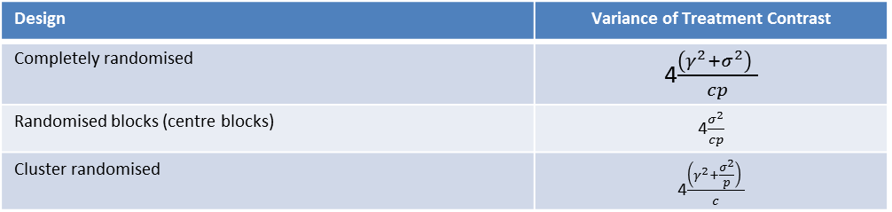
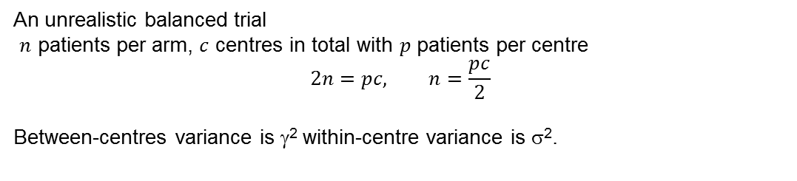
A Simple Model
An unrealistic balanced trial
$n$ patients per arm, $c$ centres in total with $p$ patients per centre
$$2n=pc, n=\frac{pc}{2}$$
Between-centres variance is γ² within-centre variance is σ².
Design | Variance of Treatment Contrast
Completely randomised | 4$\frac{\left(γ^{2}+σ^{2}\right) }{cp}$
Randomised blocks (centre blocks) | 4$\frac{σ^{2}}{cp}$
Cluster randomised | 4$\frac{\left(γ^{2}+\frac{σ^{2}}{p}\right) }{c}$
When using external controls we have at least the variability of a cluster randomised trial

Slide 29
Lessons from TARGET
If you want to use historical controls you will have to work very hard
You need at least two components of variation in your model
Between centre
Between trial
And possibly a third
Between eras
What seems like a lot of information may not be much
Concurrent control and randomisation seems to work well
Moral for any Bayesian: find out as much as possible about any data you intend to use

Slide 30
That example revisited
The question
The solution
You are proposing to estimate the probability θ of a binary event
E.g. cure/no cure
You use a uniform prior on θ
You now proceed to study 10,000 occurrences
Which does your prior distribution say is more likely?
10,000 successes
5,000 successes 5,000 failures, in any order
You started with an ‘uninformative prior
After 10,000 trials the observed proportion must be pretty much what you believe is the true probability
But you said every true probability is equally likely
Therefore 5,000 success in any order is just as likely as 10,000 success

Slide 31
Advice
Think hard about any prior distribution
Try to establish the objective content of any prior distribution
Uninformative prior distributions are not appropriate for nuisance parameters
Be prepared to think hierarchically
Check that
The prior distribution states your current belief
No data in any shape of form would cause you to abandon it
If the result seems to contradict frequentist wisdom think carefully why
Develop statistical insight – understand what being Bayesian means
As in any statistically system, ask yourself the question
How did I get to see what I see?

Slide 32
References
1 Senn, S. J. Bayesian, likelihood and frequentist approaches to statistics. Applied Clinical Trials 12, 35-38 (2003).
2 Senn, S. J. Trying to be precise about vagueness. Statistics in Medicine 26, 1417-1430 (2007).
3 Senn, S. A note concerning a selection "Paradox" of Dawid's. American Statistician 62, 206-210, doi:10.1198/000313008x331530 (2008).
4 Senn, S. J. Comment on article by Gelman. Bayesian analysis 3, 459-462 (2008).
5 Senn, S. J. Comment on "Harold Jeffreys's Theory of Probability Revisited". Statistical Science 24, 185-186 (2009).
6 Senn, S. J. You may believe you are a Bayesian but you are probably wrong. Rationality, Markets and Morals 2, 48-66 (2011).

